Slide 1
LEX
A tool widely used to specify lexical analyzers for a variety of languages
We refer to the tool as Lex compiler , and to its input specification as the Lex language.

Slide 2
Lex source prog → → lex.yy.c
lex.l
lex.yy.c → → a.out
Input stream → → sequence of input.c tokens
Lex Compiler
C compiler
a.out

Slide 3
Creating a lexical analyzer with Lex
Lex specifications:
A Lex program (the lex.l file ) consists of three parts:
1. Declarations part %%
2. Transition rules part %%
3. Auxillary procedures part

Slide 4
declarations
%%
translation rules
%%
auxiliary functions

Slide 5
Declarations
Declarations of variables, constants

Slide 6
Transition rules
The translation rules of a Lex program are statements of the form :
p1 {action 1}
p2 {action 2}
p3 {action 3}
… …
where each p is a regular expression and each action is a program fragment describing what action the lexical analyzer should take when a string pattern matches with p matches a lexeme.
In Lex the actions are written in C.

Slide 7
Auxillary procedures
The third section holds whatever auxiliary procedures are needed by the actions.
Alternatively these procedures can be compiled separately and loaded with the lexical analyzer.
The auxillary peocedures are written in C language.

Slide 8
The lexical analyzer returns a single quantity, the token, to the parser.
To pass an attribute value with information about the lexeme, we can set the global variable yylval.

Slide 9
Built-in function
1) yylex():-
This function is used for calling lexical analyzer for given translation rules.
2)yyerror():-
This function is used for displaying any error message.
3)yywrap():-
This function is used for taking i/p from more than one file

Slide 10
Built-in Variables
1. yyval(): This is a global variable used to store the value of any token.
2. yytext(): This is a global variable which stores current token.
3. yyin(): This is input file pointer used to change value of input file pointer. Default keyboard
4. yyout(): This is output file pointer used to change value of output file pointer. DefaultMonitor

Slide 11
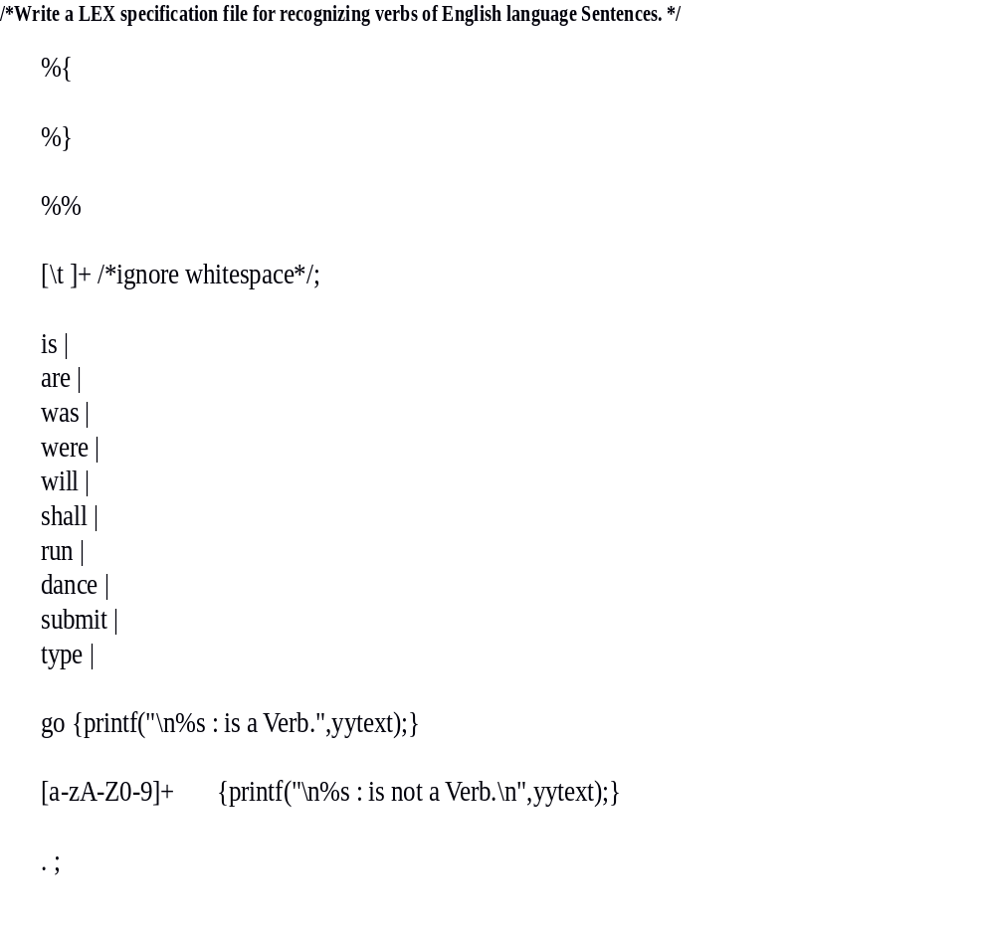

Slide 12
%%
main()
{
printf("Enter your statement : ");
yylex();
}
yywrap()
{
return 1;
}

Slide 13
Running steps
student@localhost ~]$ lex 11.l
[student@localhost ~]$ gcc lex.yy.c
[student@localhost ~]$ ./a.out
Enter your statement : this is cli lab
this : is not a Verb.
is : is a Verb.
cli : is not a Verb. lab : is not a Verb.

